Slide 1
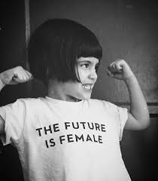
Wonder Women Quiz

Slide 2
1. What famous female author created the characters Ron, Hermione and Harry?
A) Marian Keyes
B) Beatrix Potter
C) Nicola Pierce
D) J.K. Rowling

Slide 3
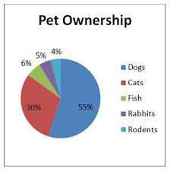
2. What is the name of the woman who invented the pie chart
A) Florence Nightingale
B) Hilary Clinton
C) Mary McAleese
D) Amelia Earhart

Slide 4
4. Which famous woman said the following quote? "I hope in God it will be seen that women in time to come will do much."
A) Hilary Clinton
B) Mary Ward
C) Anne Frank
D) Marie Curie

Slide 5
3. In what year did Mary Anderson invent the windscreen wiper?
A) 1890
B) 1990
C) 1903
D) 1910

Slide 6
5. What did Marie Curie create?
Theory of Radioactivity
Theory of Photosynthesis
Theory of Biochemistry
Theory of displacement

Slide 7
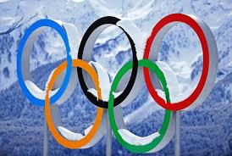
6. In what year were women allowed to compete in ski jumping events at the Winter Olympics?
2010
2007
2016
2014

Slide 8
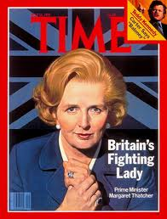
7. What political party did Margaret Thatcher represent?
Labour
Conservative
Liberal Democrats
Green Party

Slide 9
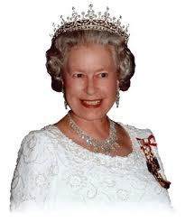
8. What language does the Queen speak fluently?
Swahili
Hebrew
Spanish
French

Slide 10
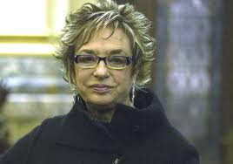
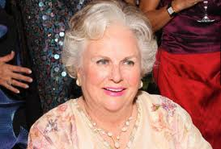
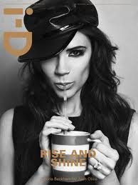
9. Who is the wealthiest woman?
B) Jacqueline Mars
Mars inc.
Rosalia Mera, CEO of Zara
D) Madhur Jaffrey
Indian Cookery
C) Victoria Beckham

Slide 11
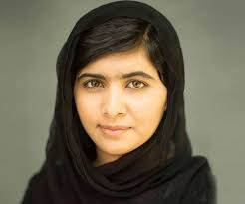
10. What country is female activist Malala Yousafzai from?
Pakistan
Iran
Saudi Arabia
Afghanistan

Slide 12
1. What famous female author created the characters Ron, Hermione and Harry?
A) Marian Keyes
B) Beatrix Potter
C) Nicola Pierce
D) J.K. Rowling

Slide 13
2. What is the name of the woman who invented the pie chart
A) Florence Nightingale
B) Hilary Clinton
C) athletics
D) singing

Slide 14
3. In what year did Mary Anderson invent the windscreen wiper?
A) 1890
B) 1990
C) 1903
D) 1910

Slide 15
4. Which famous woman said the following quote? "I hope in God it will be seen that women in time to come will do much."
A) Hilary Clinton
B) Mary Ward
C) Anne Frank
D) Marie Curie

Slide 16
5. What did Marie Curie create?
Theory of Radioactivity
Theory of Photosynthesis
Theory of Biochemistry
Theory of displacement

Slide 17
6.In what year were women allowed to compete in ski jumping events at the Winter Olympics?
2007
2010
1998
2014

Slide 18
7. What political party did Margaret Thatcher represent?
Labour
Conservative
Liberal Democrats
Green Party

Slide 19
8. What language does the Queen speak fluently?
Swahili
Hebrew
Spanish
French

Slide 20
9. Who is the wealthiest woman?
B) Jacqueline Mars
Mars inc.
Rosalia Mera, CEO of Zara
$13.8 billion
D) Madhur Jaffrey
Indian Cookery
C) Victoria Beckham

Slide 21
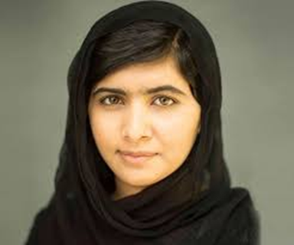
10. What country is female activist Malala Yousafzai from?
Pakistan
Iran
Saudi Arabia
Afghanistan

